Slide 1
Class 3 Trade Deficits; Currency Manipulation
PubPol 201
Module 3: International Trade Policy

Slide 2
Class 3 Outline
Trade Deficits; Currency Manipulation
Trade deficits
Definitions
What they do and do not mean
Are they a problem?
Currency manipulation
How it can be done
Criteria for naming it
China’s currency

Slide 3
Class 3 Outline
Trade Deficits; Currency Manipulation
Trade deficits
Definitions
What they do and do not mean
Are they a problem?
Currency manipulation
How it can be done
Criteria for naming it
China’s currency

Slide 4
Definitions
Balance of trade = Exports minus Imports
“Surplus” if positive
“Deficit” if negative
Reported in 2 forms
Balance of trade in goods (aka “merchandise”)
Balance of trade in goods and services

Slide 5
Definitions
Current Account Balance
Also includes
Income from abroad minus income paid to abroad
Transfer payments into country minus transfer payments out of country
Thus equals
Exports minus imports of goods and services plus net income from abroad and net transfer inflows
For most high-income countries, current account balance ≈ balance of trade.

Slide 6
Definitions
Financial Account Balance
This represents changes in financial stocks
Net increase in foreign holding of assets here Minus
Net increase in domestic holdings of assets abroad
Thus it is approximately our country’s net borrowing from abroad

Slide 7
Definitions
How the balances fit together
It must be true (if measured perfectly) that
Thus a financial account surplus could be said to “finance” a current account deficit
Current Account Balance
+
Financial Account Balance
= 0

Slide 8
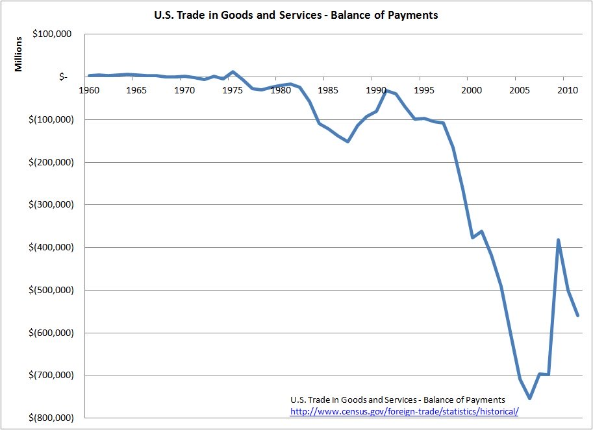
US Trade Deficit, in $ million
Notes:
https://ourfuture.org/20150113/rep-alan-grayson-explains-trade-deficit-harm

Slide 9
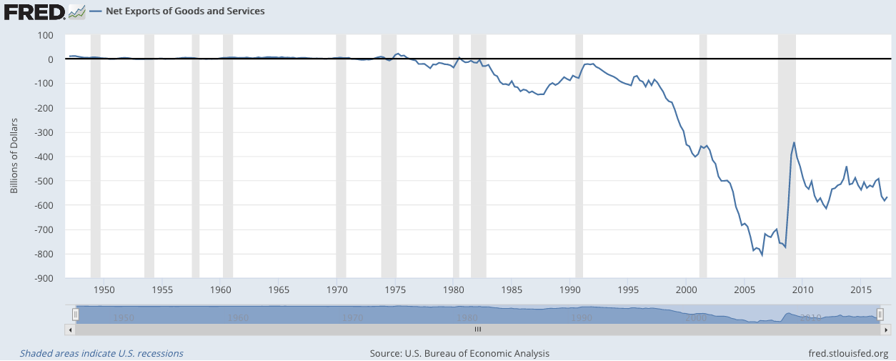
US Trade Deficit, in $
Note that trade deficit shrinks in recessions
Notes:
https://fred.stlouisfed.org/series/NETEXP

Slide 10
Trade Deficits and GDP/Unemployment
As noted above, trade deficits
Tend to decline in recessions,
And be largest in booms
Does this mean deficits either
Cause booms, or
Cause recessions?
Some say yes, but this is an example of what Professor Hall calls “causal confusion”
See below.

Slide 11
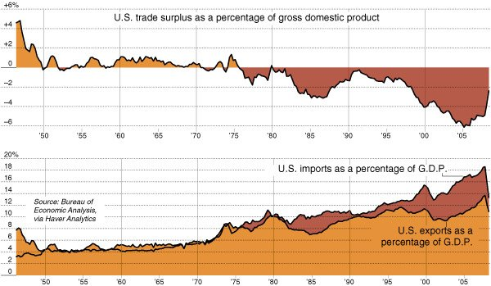
US Trade & Trade Deficit, in % of GDP
Notes:
http://www.nytimes.com/2009/05/02/business/02charts.html

Slide 12
US Bilateral Trade
Trade in goods, 2017, $ millions
US Bilateral Deficits, Largest
Country | Exports | Imports | Total | Deficit
China | 129,894 | 505,470 | 635,364 | -375,576
EU | 283,269 | 434,633 | 717,902 | -151,363
Mexico | 243,314 | 314,267 | 557,581 | -70,953
Japan | 67,605 | 136,481 | 204,086 | -68,876
Germany | 53,897 | 117,575 | 171,472 | -63,678
US Bilateral Surpluses, Largest
Country | Exports | Imports | Total | Deficit
Hong Kong | 39,939 | 7,376 | 47,315 | +32,563
Netherlands | 41,510 | 17,785 | 59,295 | +23,725
U.A.E. | 20,020 | 4,269 | 24,289 | +15,751
Belgium | 29,924 | 14,997 | 44,921 | +14,927
Australia | 24,527 | 10,045 | 34,572 | +14,482
Notes:
From http://www.trade.gov/mas/ian/build/groups/public/@tg_ian/documents/webcontent/tg_ian_003364.pdf
Via https://en.wikipedia.org/wiki/List_of_the_largest_trading_partners_of_the_United_States#cite_note-2
(But numbers don’t quite match. Don’t know why.)

Slide 13
Country balances overall (not bilateral) $
Current account balances, 2017, $ billions
Deficits, Largest
Country | Deficit
US | -466.2
UK | -106.7
India | -51.2
Canada | -49.3
Turkey | -47.1
Surpluses, Largest
Country | Deficit
EU | +404.9
Germany | +296.6
Japan | +195.4
China | +164.9
Netherlands | +80.9
Notes:
CIA World Factbook: https://www.cia.gov/library/publications/the-world-factbook/rankorder/2187rank.html

Slide 14
Country balances overall (not bilateral) %GDP
Current account balances, 2016, & rank of 74
Deficits, Selected Largest
Country | Rank | Deficit
Bhutan | 1 | -27.7
UK | 14 | -4.4
Canada | 23 | -3.3
Australia | 28 | -2.7
US | 31 | -2.6
Surpluses, Selected Largest
Country | Rank | Deficit
Singapore | 1 | +19.0
Switzerland | 2 | +10.7
Germany | 4 | +8.3
Japan | 17 | +3.8
China | 22 | +1.8
Notes:
World Bank: https://data.worldbank.org/indicator/BN.CAB.XOKA.GD.ZS?name_desc=false

Slide 15
Class 3 Outline
Trade Deficits; Currency Manipulation
Trade deficits
Definitions
What they do and do not mean
Are they a problem?
Currency manipulation
How it can be done
Criteria for naming it
China’s currency

Slide 16
What the Trade Balance Does Not Mean
Common Misinterpretations
That a deficit means we are “losing money”
This was sort of true
When
All money was gold (the Gold Standard), and
There were no international capital flows
Then imports > exports meant you were spending more gold than you were earning; Gold was flowing out
Today there are capital flows
A country with imports > exports can
Borrow
Sell assets to foreigners

Slide 17
What the Trade Balance Does Not Mean
Common Misinterpretations
That a deficit means we are “losing jobs”
It is true that
Imports are goods we don’t produce, and
Exports are goods we do produce
But whether an increase in imports means a loss of jobs depends on why imports went up
Often it is because more people are working, earning income, and buying more from abroad

Slide 18
What the Trade Balance Does Not Mean
Common Misinterpretations
That a deficit means other countries are misbehaving, by restricting imports or subsidizing exports
No

Slide 19
What the Trade Balance Does Mean
From National Income Accounting
(I’ll do this first without government)
Recall from Econ 102 (if you’ve had it)
GDP = Output = Income = Y
Output:
Y = C + I + (X − M)
Income:
Y = C + S
Therefore
X − M = S − I
Where
C = Consumption
I = Investment
X = Exports
M = Imports
S = Savings

Slide 20
What the Trade Balance Does Mean
From National Income Accounting
Thus, since X − M = S − I
Trade surplus ⇒ savings > investment
Trade deficit ⇒ savings < investment
If we are not saving enough to finance investment, how do we pay for it?
By borrowing from abroad, or
By selling assets

Slide 21
What the Trade Balance Does Mean
From National Income Accounting
(This time with government)
Even more simply
Y = C + I + G + (X − M)
implies
X − M = Y − (C + I + G)
Where
G = Government purchases of goods & services (not transfer payments)

Slide 22
What the Trade Balance Does Mean
Thus
(X − M) = Y − (C + I + G)
So a trade deficit
(X − M) < 0
means that we are spending
(C + I + G)
more than our income Y
Trade Surplus
Income
Expenditure

Slide 23
What the Trade Balance Does Mean
Therefore, in spite of its name, and it’s definition, the trade balance
Is not really about trade, which is just the symptom
It is about whether we are living within our means
If we are spending more than our income
Then we are buying more than we are producing
And we must import the difference
Thus running a trade deficit

Slide 24
Trade Deficits and GDP/Unemployment
Do deficits either
Cause booms, or
Cause recessions?
No. Causation is the other direction
When income rises in a boom, so does spending, and trade deficit grows
When income falls in a recession, so does spending and the trade deficit shrinks

Slide 25
Class 3 Outline
Trade Deficits; Currency Manipulation
Trade deficits
Definitions
What they do and do not mean
Are they a problem?
Currency manipulation
How it can be done
Criteria for naming it
China’s currency

Slide 26
Are Trade Deficits a Problem?
Mankiw reading
Mankiw is a Harvard professor.
He was also Chair of Council of Economic Advisors under George W. Bush
And later advisor to Mitt Romney
He makes several points:
Money that flows out for imports comes back for exports and capital inflows
Deficit was largest when unemployment was lowest, because high income causes high imports
Trump’s intended policies (e.g., tax cuts, infrastructure spending) will increase the trade deficit

Slide 27
Are Trade Deficits a Problem?
When is a trade deficit good?
When the country (like a young person) is investing for the future (like a successfully developing country)
Not when it is going into debt just to finance current consumption (like the US)

Slide 28
Are Trade Deficits a Problem?
Lankford reading
Note that the author of this opinion piece is a Republican senator (from Oklahoma)
He makes two points:
That our trade deficit with Mexico is due to our much higher income. We can afford to buy more than they can, and hence we do.
The deficit also reflects the fact the foreigners want to invest in the US and when they do, that money flowing in for investment requires that money flow out in a trade deficit. But foreign investment into the US benefits us.

Slide 29
Are Trade Deficits a Problem?
Lankford reading
His first point is suspect.
US per capita income is higher
But that doesn’t mean that our consumption can exceed our income by more, as a deficit implies
Unless, perhaps, it means we have better credit and can borrow
His second point is good
Foreigners’ investments here are inflows in the Financial Account
They must be matched by outflows in the current account

Slide 30
What about Bilateral imbalances?
There is no reason why bilateral trade should be balanced
Depending on who is exporting importing what, it may make sense for a country to
Mainly buy (import) from one country, and
Mainly sell (export) to another country
Example
China has lots of labor but few natural resources
So it imports resources from Australia, and
Exports manufactures to the US

Slide 31
What about Bilateral imbalances?
Can tariffs change bilateral imbalances?
Yes
Tariffs on one country won’t change how much we import overall, but they can change from whom we import
The tariff on imports from China should
Reduce our bilateral deficit with China
Increase our deficit with other countries, as we import the goods from them instead of from China

Slide 32
Discussion Question
Why do President Trump and others see trade deficits of the US, both overall and bilateral, as bad?
Do they see them as signs of bad US policies or of bad policies of other countries?

Slide 33
Class 3 Outline
Trade Deficits; Currency Manipulation
Trade deficits
Definitions
What they do and do not mean
Are they a problem?
Currency manipulation
How it can be done
Criteria for naming it
China’s currency

Slide 34
Exchange Rates
How are they determined?
By markets – supply and demand
That’s all, in countries with a “floating exchange rate”
US, EU, Canada, Mexico, and others
By governments intervening in markets
Selling their own currency and buying others to push their currency down
Buying their own currency and selling others to push their currency up

Slide 35
Exchange Rates
Exchange-market intervention
Is done, if at all, by the Central Bank (CB)
Requires “International Reserves”
Of foreign currencies (usually the US dollar), or
Of foreign assets denominated in foreign currency
Reserves
Rise when intervention pushes down the domestic currency (since CB buys $)
Fall when intervention pushes up the domestic currency (since CB sells $)

Slide 36
Exchange Rates
Currency Manipulation
Usually defined as intervention intended to reduce the value of a country’s own currency
In order to make its exports more competitive, and
Discourage imports
Other countries object to it, because it reduces their exports
Congress requires the US Treasury Department to report twice a year on currency manipulation

Slide 37
Exchange Rates
Currency Manipulation
Many have accused China, especially, of currency manipulation over the years
Trump promised, during the campaign, to label China a currency manipulator “on his first day in office.” He did not.
Had he done so, according to the FT reading, it
would have authorized “the US to do nothing except negotiate with Beijing over the renminbi, which it is already doing.”
In April 2018, the third such report under Trump did not label China a currency manipulator

Slide 38
Class 3 Outline
Trade Deficits; Currency Manipulation
Trade deficits
Definitions
What they do and do not mean
Are they a problem?
Currency manipulation
How it can be done
Criteria for naming it
China’s currency

Slide 39
Exchange Rates
US criteria for currency manipulation
As of April 2016, per Bergsten-Gagnon reading
has $55 billion or more of annual trade with the United States (to count as a “major trading partner”);
(Economist reading omits this)
runs a bilateral trade surplus with the United States exceeding $20 billion over the past 12 months;
runs global current account surplus exceeding 3 percent of the country’s GDP over the past 12 months; and
engages repeated net foreign exchange purchases exceeding 2 percent of the country’s GDP over the past 12 months.

Slide 40
Class 3 Outline
Trade Deficits; Currency Manipulation
Trade deficits
Definitions
What they do and do not mean
Are they a problem?
Currency manipulation
How it can be done
Criteria for naming it
China’s currency

Slide 41
“When a flow becomes a flood” Jan 22nd 2009 (The Economist print edition)

Slide 42
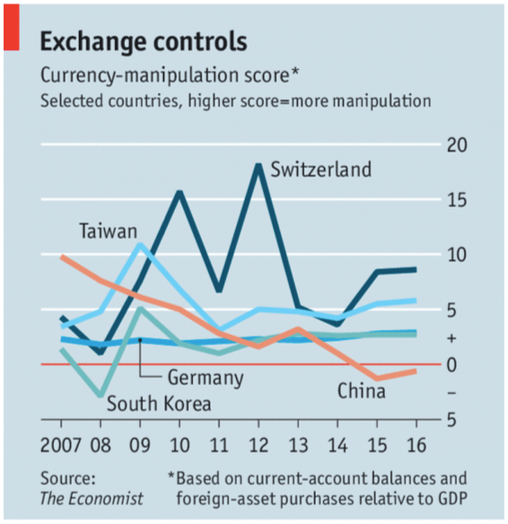

Slide 43
How a Floating Exchange Rate Behaves US$/euro Exchange Rate
It moves up and down a lot.

Slide 44
China’s Exchange Rate, US$/Yuan, 2000-2018
The exchange rate did not change at all between 2000 and 2005
Notes:
China currency.xlsx
From IMF, IFS

Slide 45
And reserves more than quadrupled!
Notes:
See China Currency.xlsx

Slide 46
Currency Manipulation
The US Dollar vs Chinese Renminbi
It is clear from the two graphs that
China was pegging their currency to the US dollar in 2000-2005
To do so they were buying dollars and thus accumulating almost $1 trillion of reserves
This led policy makers in the US to complain, and in 2005 China let its currency rise

Slide 47
China’s Exchange Rate, US$/Yuan, 2000-2018
The yuan appreciated steadily between 2005 and 2008
Notes:
China currency.xlsx
From IMF, IFS

Slide 48
Currency Manipulation
But China’s reserves continued to rise, indicating that it was still buying dollars.

Slide 49
Reserves continued to rise, to almost $2 trillion
Notes:
See China Currency.xlsx

Slide 50
Currency Manipulation
The financial crisis of 2008 slowed down both
The appreciation of the renminbi, and
The growth of reserves

Slide 51
China’s Exchange Rate, US$/Yuan, 2000-2018
The yuan stopped rising in 2008, then rose slowly
Notes:
China currency.xlsx
From IMF, IFS

Slide 52
Reserves mostly rose after 2008, to over $4 trillion in 2014
Notes:
See China Currency.xlsx

Slide 53
Currency Manipulation
The financial crisis of 2008
Slowed down the appreciation of the renminbi, off and on
But reserves continued to grow rapidly in most periods until 2014
China’s purchases of US dollars were still holding down the yuan’s value, or slowing its rise
But all that changed in 2014

Slide 54
China’s Exchange Rate, US$/Yuan, 2000-2018
The yuan reached its peak in 2013, and began to fall in 2015
Notes:
China currency.xlsx
From IMF, IFS

Slide 55
From 2014-16, China’s reserves were falling
Notes:
See China Currency.xlsx

Slide 56
Currency Manipulation
Starting in 2014
The renminbi fell against the US dollar
Chinese reserves declined, by almost $1 trillion
This means that China’s CB was
Selling dollars, not buying them
Thus pushing the dollar down, not up
And the renminbi up, not down.
So China WAS intervening
But not to push its currency down

Slide 57
China’s Exchange Rate, US$/Yuan, 2000-2018
Most recently, the yuan has moved up in 2017, down in 2018
Notes:
China currency.xlsx
From IMF, IFS

Slide 58
While reserves have moved little
Notes:
See China Currency.xlsx

Slide 59
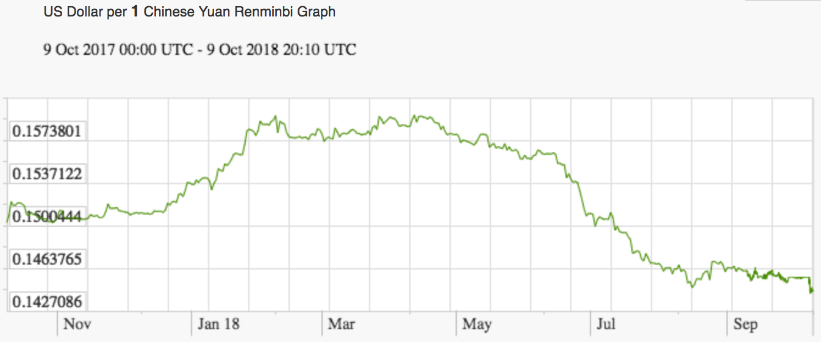
Currency Manipulation
Recent movements of the Chinese currency
9%

Slide 60
Discussion Question
In 2008, responding to the financial crisis and global recession, the US Fed used a new method to push down US interest rates. This caused the US dollar to depreciate, and other countries complained that this was making it harder for them to compete and deal with their own recessions.
Was the US engaged in currency manipulation? Were the complaints justified?

